Slide 2
Credit Card Fraud Detection
Machine Learning Project
Building a Production-Ready Fraud Detection System
Authors: Ramesh Bartaula & Niraj K Mali

Slide 3
📊 Dataset Overview
Total Transactions
The Challenge
100,000
🔴 Extreme class imbalance (99.83% vs 0.17%)
📊 Default threshold inadequate for imbalanced data
Fraudulent Cases
1,000 (1%)
⚡ Outlier sensitivity in transaction amounts
⚖️ Must balance catching fraud vs false alarms
Legitimate Cases
🎯 Need temporal & behavioral patterns
99,000 (99%)
Class Imbalance Ratio
99:1

Slide 4
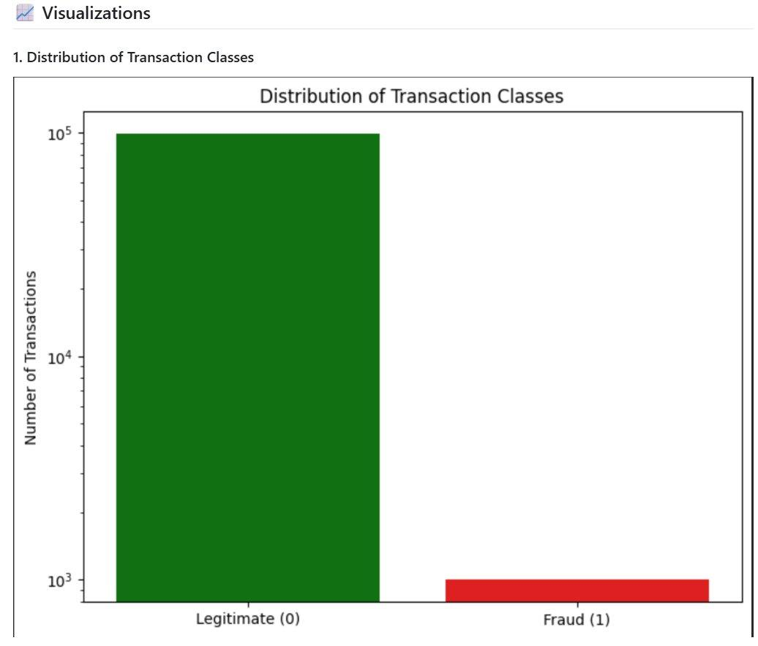
📊 Visualization 1: Distribution of Transaction Classes
Key Insight
📌 Legitimate: 99%
📌 Fraudulent: 1%
🎯 Extreme imbalance visible on logarithmic scale
⚠️ Challenge: Model must learn fraud patterns from rare examples

Slide 5
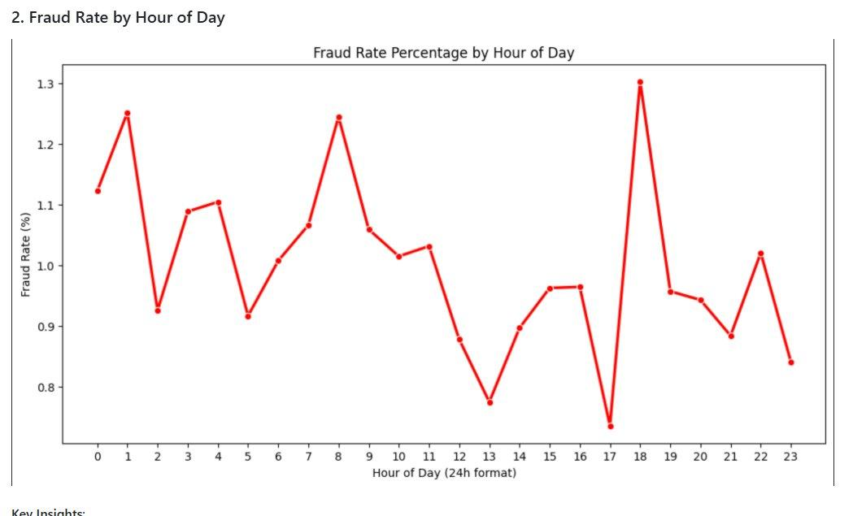
⏰ Visualization 2: Fraud Rate by Hour of Day
Key Insights
🔴 Peak hours:
6PM
4 PM
8 AM
Lowest hours:
1 PM
5 PM

Slide 6
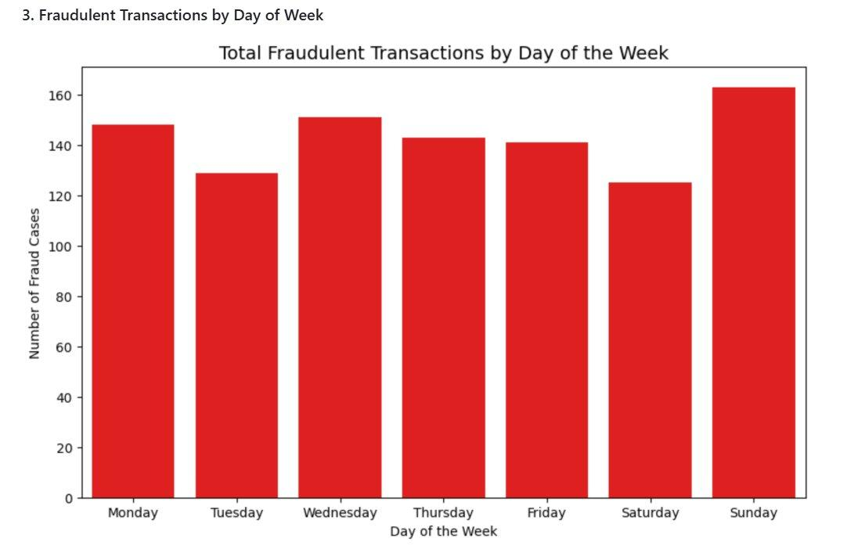
Visualization 3: Fraudulent Transactions by Day of Week
Key Insights
📍 Peak day:
Sunday
📍 Lowest day:
Saturday
🔄 End-of-week anomaly
🔄 Weekend dip pattern
✅ Day-of-week feature captures behavioral patterns

Slide 7
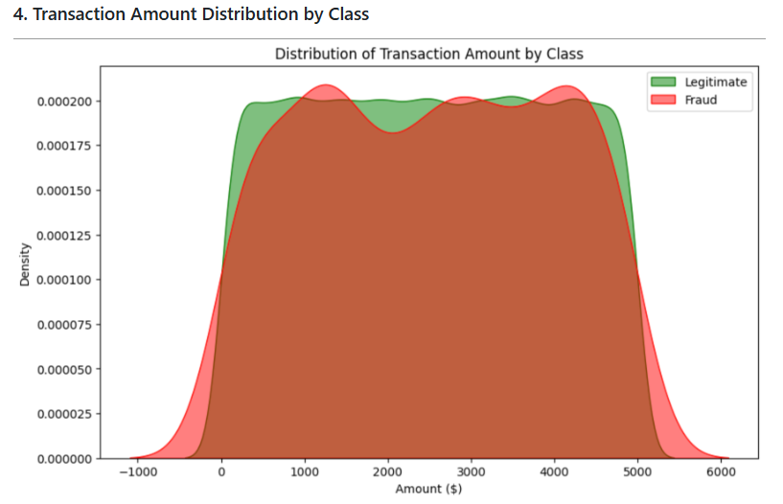
Visualization 4: Transaction Amount Distribution by Class
Key Insights
📊 Similar distributions
🔴 Fraud & Legitimate show similar amount patterns
⚠️ Amount alone is weak discriminator

Slide 8
🔄 Addressing Class Imbalance: SMOTE Solution
Before SMOTE (Training Data)
After SMOTE (Balanced Training)
Normal: 69,300 (99%)
Normal: 9,300 (50%)
❌ Without SMOTE
✅ With SMOTE
• Model: "Always predict Normal"
• Model learns fraud patterns
• Accuracy: 67% (realistic)
• Accuracy: 99% (useless)
• Fraud caught: 62%+ ✓
• Fraud caught: 0%

Slide 9
🎯 Model Results: Performance Comparison
Metric
Logistic Regression
Random Forest
Accuracy
0.67
0.67
Recall
0.66
0.62
AUC-ROC
0.73
0.72
🏆 Winner: Logistic Regression (Baseline)
✓ Higher recall (0.66 vs 0.62) — catches more fraud
✓ Better AUC-ROC (0.73 vs 0.72) — better discrimination
✓ Simpler model = faster inference in production
✓ Same accuracy (0.67) with better fraud detection

Slide 10
📊 Confusion Matrix & Threshold Tuning
Confusion Matrix (Threshold = 0.25)
Threshold Optimization
Act: Normal
20,034
9,666
Threshold | Recall | Caught
0.20 0.95 284
Act: Fraud
115
185
0.25 0.92 276
0.30 0.85 256
0.35 0.78 235
TN: 20,034 | FP: 9,666
FN: 115 | TP: 185
0.45 0.66 197 ✓
Fraud Detection Rate: 61.7%

Slide 11
✅ Key Findings & Solutions
1️⃣ Class Imbalance is Critical
SMOTE balanced fraud/normal ratio from 1:99 to 1:1 in training data
2️⃣ Default Threshold Fails
Custom threshold (0.45) catches 66% of fraud vs default 0.5 catching 37%
3️⃣ Temporal Patterns Matter
Fraudsters peak at 6 PM , 4 PM and Sunday peak
4️⃣ Simpler is Better
Logistic Regression outperformed Random Forest — faster & more interpretable

Slide 12
🎯 Conclusion
● This project demonstrates production-ready ML engineering applied to fraud detection
● Smart techniques (SMOTE, threshold tuning, feature engineering) overcome class imbalance
● Logistic Regression baseline proved simpler models can outperform complex ensembles
● Real-world trade-offs between catching fraud and false alarms are properly managed

